Slide 1
Pandemic and Retail
How Pandemic affected retail

Slide 2
Ryan

Slide 5
Bilikisu
Pandemic affected the whole world and not just the retail.
We look at the following sectors of retail
Department_Stores
Electronics_Appli
Food_Serv_Drink
Food_Beverage
Furniture_HomeFurnis
Health_Personal_Care
Retail was mostly affected due to the lockdown and both consumer and retail store have to pivot to online e-commerce.
The below plot show the pre-pandemic sales and the dip across all over different area of retail.

Slide 6
Process
We pull data from census.gov.
Clean the data dropped null.
The data was separated to pre and post pandemic timeframe.
Then ran analysis on the data, by calculating the mean , standard deviation and also perform correlation analysis to verify if the pandemic in fact affect retail as a whole .
Read file to an output clean folder.

Slide 7
Result
Base on the above plot we could see that pandemic affected sale in every sector of retail
We can infer that at the height of pandemic which is march 2020 to April 2020 every area of retail took a hit due to lock down and restriction.
We can also see that as the retail sector start to pivot and transition to online sales gradually starts to incline.
During the analysis of the pre and post pandemic we could also see that section that have strong positive correlated remain the same and correlation change with sectors that are not

Slide 8
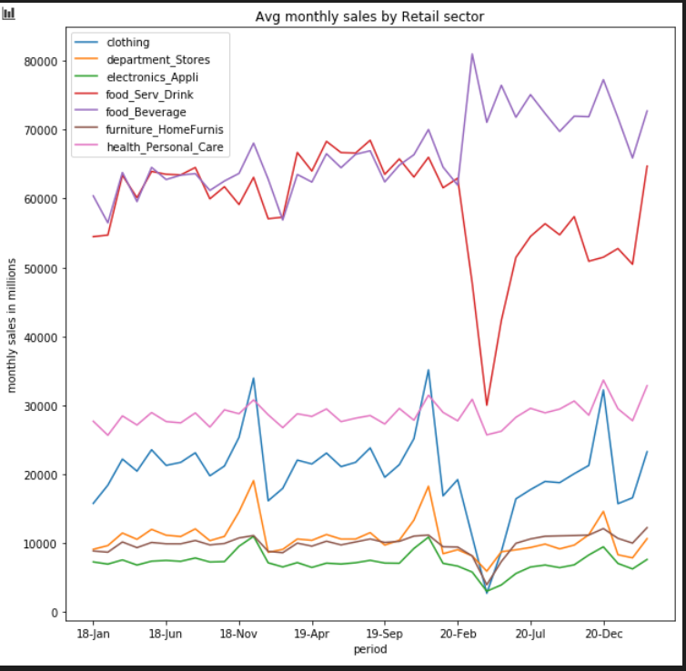

Slide 9
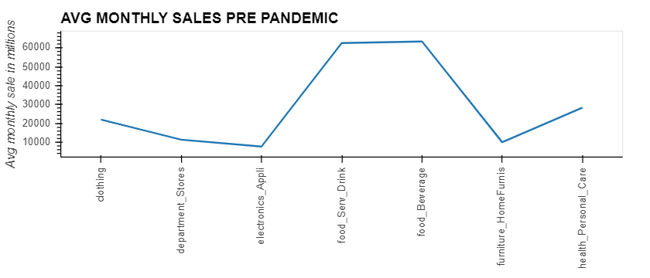
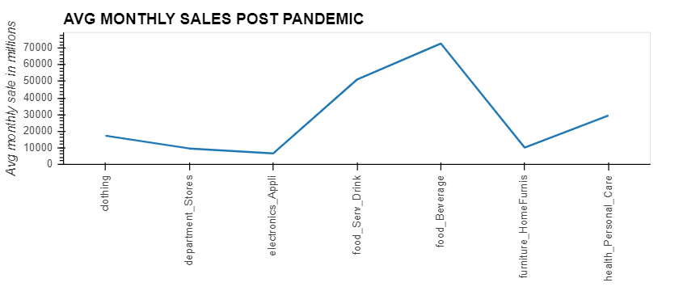

Slide 10
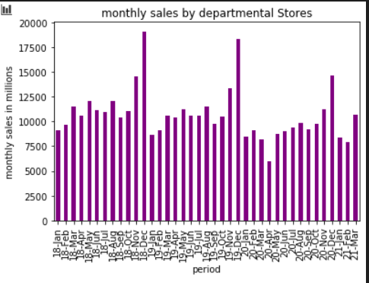
The below plot shows the
The below plot shows the monthly sale by department store

Slide 11
Conclusion

Slide 12
Frank

Slide 17
Quang

